Slide 1

Store Item Demand Forecasting using Deep Learning
Punia, Sushil et al. "Deep learning with long short-term memory networks and random forests for demand forecasting in multi-channel retail". International Journal of Production Research. 2020, 58(16). 4964-4979. https://doi.org/10.1080/00207543.2020.1735666
Presented by – Akash Savaliya

Slide 2
Problem Statement
In most manufacturing businesses, knowing the market demand ahead of time is critical for planning resources and expenses to keep the business running smoothly.
Demand forecasting is the term used to describe the difficulty of projecting demand.
Demand forecasting not only eliminates demand uncertainty, but it also provides insight into customer or client purchasing patterns.
Retail is one of the industries that contributes significantly to the manufacturing sector.
Demand forecasting for retail industry will make their supply and demand under control.

Slide 3
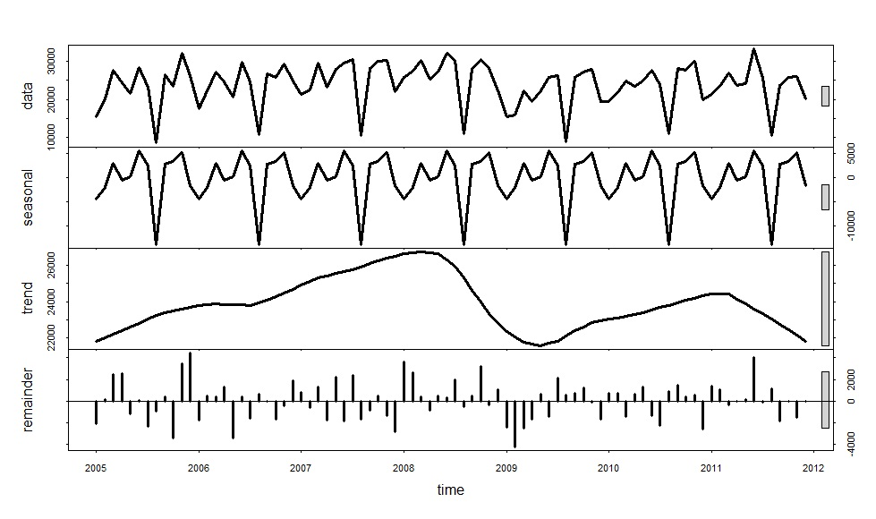
Data
The data is published on UCI Machine Learning Repository on this link https://archive.ics.uci.edu/ml/datasets/online+retail
The data consists day on day transactions of an online retail store.
The features in this data includes InvoiceNo, StockCode, Description, Quantity, InvoiceDate, UnitPrice, CustomerID and Country

Slide 4
Motivation
Solving demand forecast problem helps in building marketing strategies and portrays a paradigm shift in consumer behavior and risk mitigation strategies.
Demand forecasting makes a future estimate of the uncertain situations based on the past experiences.
Such solution can be very useful in not only manufacturing or retail industry but in the financial market as well to forecast stock prices to gain huge profits.

Slide 5
Survey on Related Work
Ilan Alon,et al."Forecasting aggregate retail sales:: a comparison of artificial neural networks and traditional methods" Journal of Retailing and Consumer Services. 2001,8(3). 0969-6989. https://doi.org/10.1016/S0969-6989(00)00011-4
This paper gives a comparison between the artificial neural network and traditional methods used for forecasting problems.
Based on the work mentioned in the paper it concludes that the ANN works efficiently than the traditional methods.

Slide 6
Survey on Related Work
Pedro Lara-Benítez, Manuel Carranza-García, José C. Riquelme."An Experimental Review on Deep Learning Architectures for Time Series Forecasting" International Journal of Neural Systems. 2021,31(3). 2130 - 0011. https://arxiv.org/abs/2103.12057
This paper gives a comparison of performance of multiple deep learning models to solve the forecasting problem.
The paper concludes that LSTM works the best among the deep learning models for forecasting problem.

Slide 7
Method Summary
The implementation of this paper uses two models LSTM and Random Forest
The model takes in the time series and other transactional data. The time series data is then fed to the LSTM and outputs the forecast.
The residuals from this forecasted data is then fed to the random forest along with the transactional data to predict the residuals.
The final output of the complete model is the combination of forecast value from LSTM and the residuals from Random Forest.
The approach of combining two different model results leads to better results and less error.

Slide 8
Plan
Week | Task
Week 1 | Data Cleaning and Data Preparation
Week 2 | Data Preprocessing and Data Visualization
Week 3 | Model Preparation and Initial Runs
Week 4 | Improving Model Performance(hyperparameter tuning, feature removal, etc.)

Slide 9
Thank You!!!

